Slide 1
Paper 1:
Information Systems Success Revisited
DeLone, W. H., & McLean, E. R. (2002).
Proceedings of the 35th Hawaii International Conference on System Science
Paper 2:
Information Systems Success: The Quest for the Independent Variable
Petter, S., DeLone, W. H., & McLean, E. R. (2013).
Journal of Management Information Systems, 29(4), 7-61.
Presented by Hacer Bilü
18.12.2017 - IS740: Information Technology Acceptance in Organizations
Notes:
The two paper are interrelated.
The first one is a review of articles&papers between 1993-1999.
- The paper reexamined and reformulated “the DeLone and McLean IS Success Model”
Whereas the second one is a review of the literature between 1992-2007.
- The paper identifies the determinants that have an direct impact on IS Success.

Slide 2
Presentation Outline
The Original D&M IS Success Model
Updated D&M IS Success Model
Determinants of IS Success

Slide 3
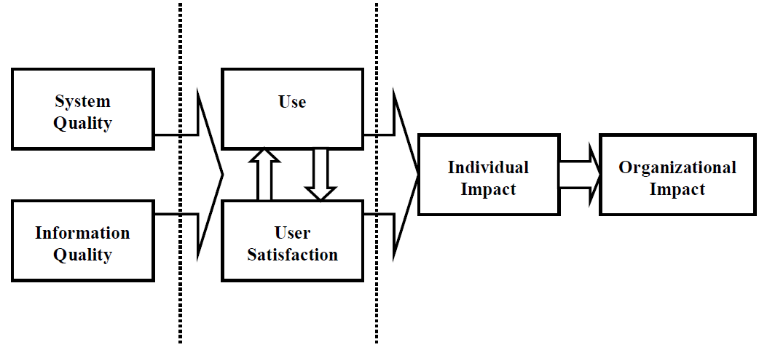
The D&M IS Success Model
(DeLone & McLean, 1992, p. 87)
The D&M IS Success Model is a framework that measure Information System Success.
There were 6 interrelated dimensions of IS Success: System Quality, Information Quality, System Use, User Satisfaction, Individual Impacts, and Organizational Impacts.
The model was formed as a result of review which examines nearly 200 research papers published betweem 1981 and 1987.
Interrelationships among the dimensions in the model were not tested empirically.
Information Systems Success Revisited (Delone & Mclean, 2002)

Slide 4
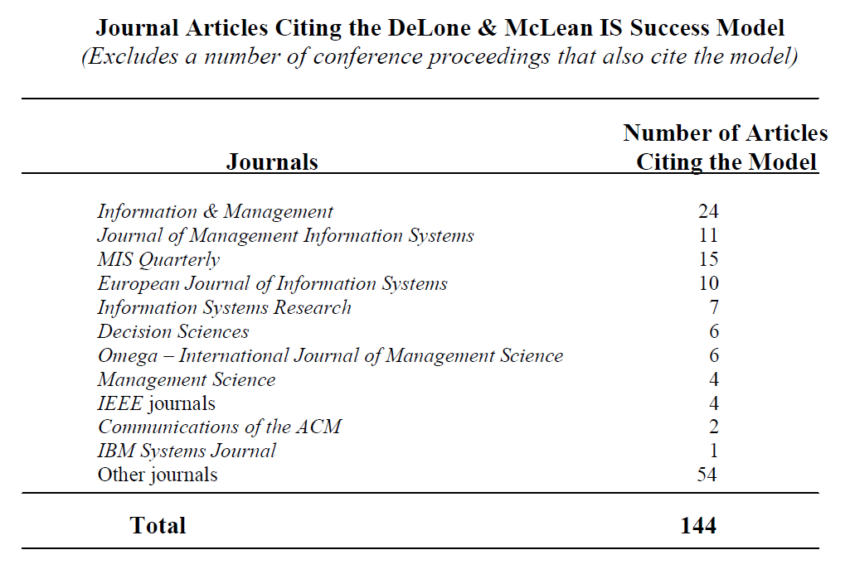
Updated D&M IS Success Model
144 refereed journal articles and 15 papers from ICIS (the International Conference on Information Systems) were review to reformulate the D&M IS Success Model.
All these articles & papers have referenced the D&M Model during 1993 to 1999.
Information Systems Success Revisited (Delone & Mclean, 2002)

Slide 5
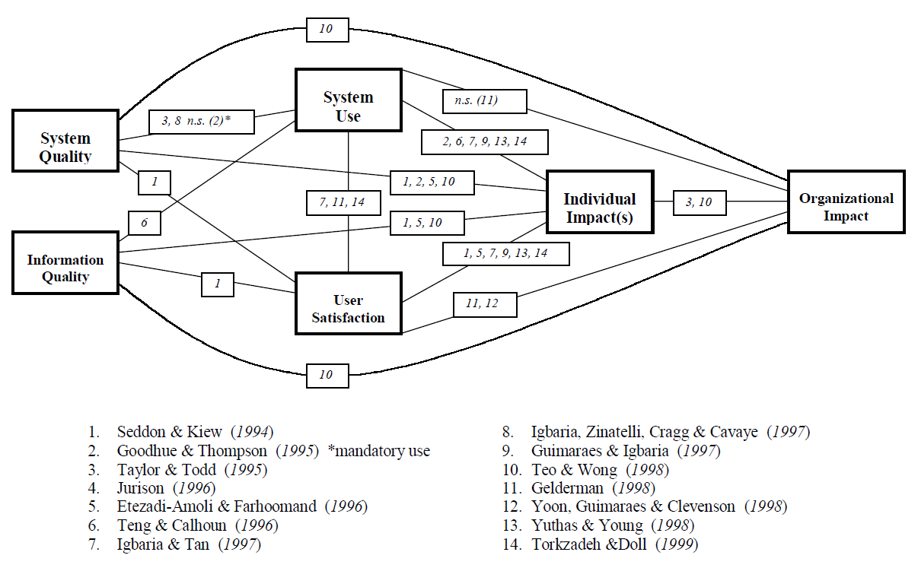
Updated D&M IS Success Model
In the 1992 article, interrelationships among the dimensions in the model were not tested empirically.
Some studies confirmed (not confirmed) these interrelationships.
Information Systems Success Revisited (Delone & Mclean, 2002)
Notes:
Figure displays the D&M IS Success Model and the relationships confirmed (or not confirmed) in the cited empirical studies.

Slide 6
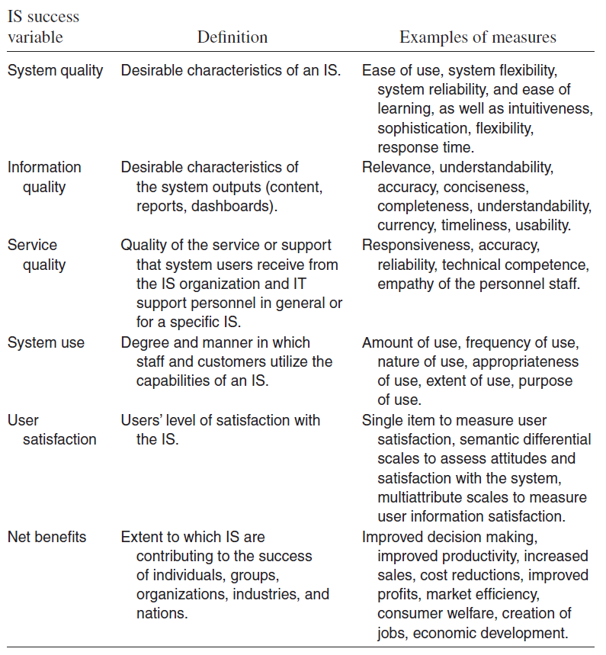
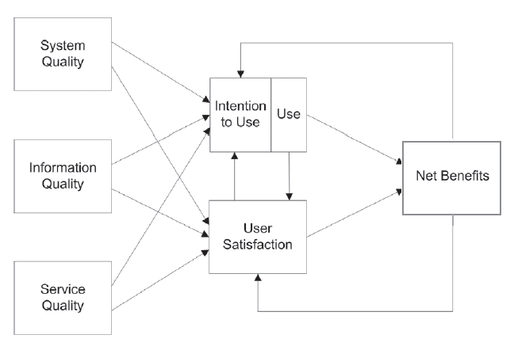
Updated D&M IS Success Model
Information Systems Success: The Quest for the Independent Variables (Petter, Delone & Mclean, 2013)

Slide 7
Updated D&M IS Success Model
Service Quality was added to the model as a component of IS success.
For a single system, Information Quality or System Quality may be the most important quality components.
For measuring the overall success of IS department, Service Quality may become a more important variable.
Due to the difficulties in interpreting the multi-dimensional aspects of Use, Intention to Use was suggested as a alternative mesaure.
Intention to use is an attitude.
Use is a behavior.
Positive experience with Use will lead to greater User Satisfaction.
Increased User Satisfaction will lead to Intention to Use and thus Use.
As a result of this Use and User Satisfaction, certain Net Benefits will occur. Net benefits provide different levels of benefits (i.e., individual, group, organizational, societal).
Information Systems Success Revisited (Delone & Mclean, 2002)
Notes:
The lack of positive benefits is likely to lead to decreased Use of the system or decreased User Satisfaction.

Slide 8
Determinants of IS Success
The main objective of the review is to explore “What causes IS success?”
Research Method:
It is a qualitative literature review which analyze and evaluate both quantitative and qualitative researches within a domain to draw conclusions about the state of the field.
Search Method:
First, researchers performed full-text searches in a number of online databases (EBSCOhost, ABI/Inform, and Web of Knowledge) using the keywords “IS Success”, “IS effectiveness” and “DeLone and McLean”.
Second, they performed a citation search using the Web of Science database on the original DeLone and McLean paper, the updated DeLone and McLean paper, and the Seddon response paper.
As a result, researchers identified over 600 papers published between 1992 and 2007.
The following papers were eliminated from this review;
Ones focused solely on instrument development.
Ones did not examine predictors of IS Success.
Literature reviews or meta-analysis related to IS Success
Researches examining the variables that act as control variables or moderators of IS Success.
After the elimination process, 140 studies examined for the analysis.
Information Systems Success: The Quest for the Independent Variables (Petter, Delone & Mclean, 2013)

Slide 9
Determinants of IS Success
To classify the antecedents of IS success, two researchers worked independently
One researcher recorded the relevant relationship findings in a document.
S/he identified 303 relationships.
Second researcher (was given the 303 relationships identified, along with definitions of the five categories) grouped the relationships into the five categories: Task, User, Social, Project, and Organizational.
Second researcher also created an “other” category for the relationships that did not fit within the 5 categories.
Both researchers revisited the original papers to classify these variable into one of the five categories.
Using Cohen’s kappa to assess interrater reliability, the two researchers achieved κ = 0.81 in their grouping of the relationships into the five categories, which demonstrates a high level of interrater reliability.
After the high-level categories were determined, researchers
identified/named the ancedent variables
classified them within each of the 5 categories based on the definitions of the variables and the measures used for each of the variables.
This process identified 43 unique success factor variables within the five resulting success factor categories.
Information Systems Success: The Quest for the Independent Variables (Petter, Delone & Mclean, 2013)
Notes:
For example, task compatibility may be called “compatibility” in one study, but called “task–technology fit” in another study.

Slide 10
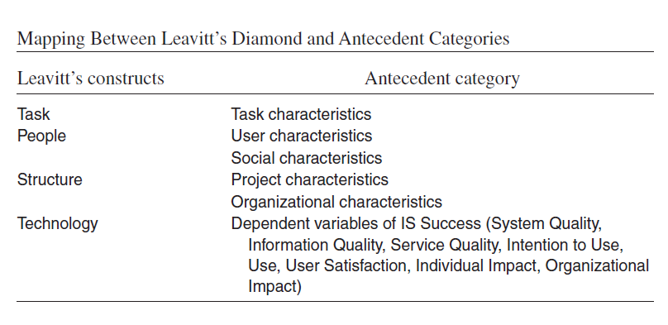
Determinants of IS Success
The categories that emerged from the data are consistent with Leavitt’s Diamond of Organizational Change.
Information Systems Success: The Quest for the Independent Variables (Petter, Delone & Mclean, 2013)

Slide 11
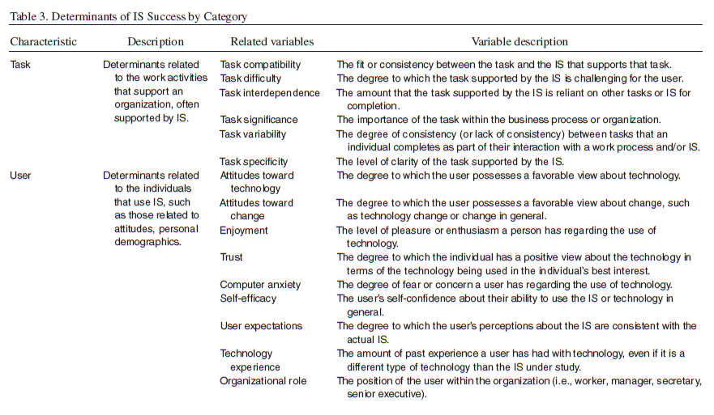
Determinants of IS Success
Information Systems Success: The Quest for the Independent Variables (Petter, Delone & Mclean, 2013)

Slide 12
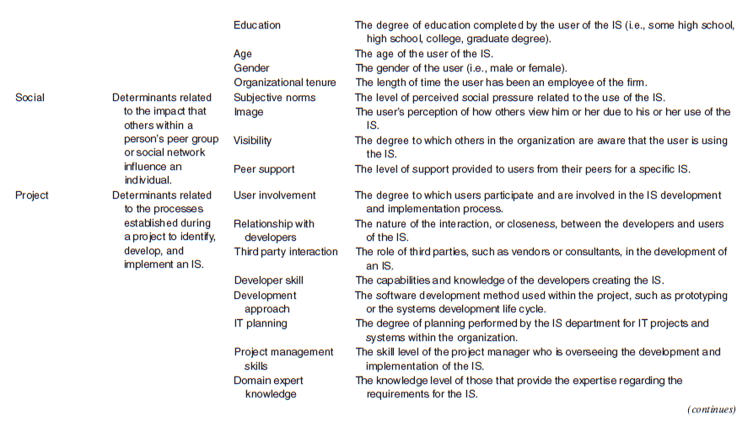
Determinants of IS Success
Information Systems Success: The Quest for the Independent Variables (Petter, Delone & Mclean, 2013)

Slide 13
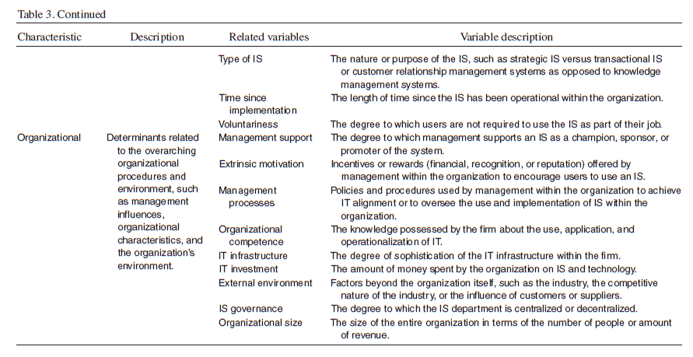
Determinants of IS Success
Information Systems Success: The Quest for the Independent Variables (Petter, Delone & Mclean, 2013)

Slide 14
Determinants of IS Success
Analyzing Relationships
Researchers could not perform statistical meta-analysis because the study includes both quantitative and qualitative studies.
Analysis Method
A study that fully supports the relationship between the antecedent and measure of IS success, a score of 1.0 point is assigned.
A study with mixed results receives a score of 0.5 points.
A study not supporting the relationship received 0.0 points.
The sum of the points is divided by the number of unique studies that examined the relationship in question.
Relationships are considered
“strong” if the percentage of papers supporting the relationship is 90 percent to 100 percent.
“moderate” support if the percentage of papers supporting the relationship is 67 percent to 89 percent.
Relationships for which there are four or fewer studies were not evaluated using this criteria since there would be insufficient data to make a determination about the nature of the relationship.
Information Systems Success: The Quest for the Independent Variables (Petter, Delone & Mclean, 2013)

Slide 15
Determinants of IS Success
Analyzing Relationships
Through this analysis, researchers
found 5 antecedents with a strong relationship to overall IS success.
Enjoyment, Trust, User Expectations, Extrinsic Motivation, and IT Infrastructure
identified 10 antecedents that have moderate support for the relationship between the antecedent and overall IS success.
Task Compatibility, Task Difficulty, Attitudes Toward Technology, Organizational Role, User Involvement, Relationship with Developers, Domain Expert Knowledge, Management Support, Management Processes, and Organizational Competence.
identified 12 constructs having a strong/moderate level of support with a specific measure of IS success:
Task Compatibility, Task Difficulty, Attitudes Toward Technology, Self-Efficacy, User Expectations, Technology Experience, User Involvement, Management Support, Management Processes, Extrinsic Motivation, Organizational Competence, and IT Infrastructure.
Information Systems Success: The Quest for the Independent Variables (Petter, Delone & Mclean, 2013)
Notes:
Researchers analyzed each of the antecedents using the same criteria for the relationships between the antecedent and the specific measure of IS success.

Slide 16
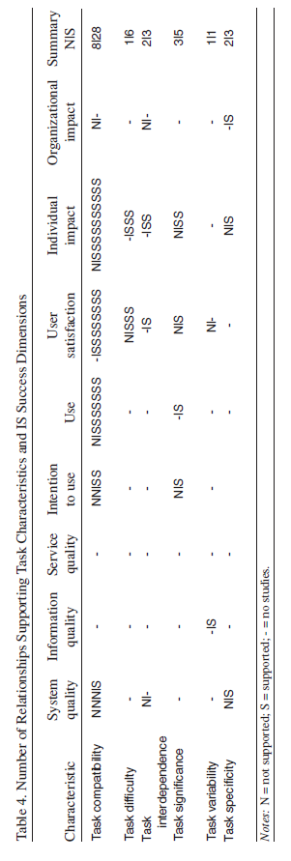
Determinants of IS Success
Task Characteristics - Determinants related to the work activities that support an organization, often supported by IS.
Task Compatibility and Task Difficulty had a moderate level of support as antecedents of overall IS success.
Task difficulty has an inverse relationship with IS success in that the easier the task, the more successful the IS.
Information Systems Success: The Quest for the Independent Variables (Petter, Delone & Mclean, 2013)
Notes:
Task Compability, 28/36 = 0.78 - %78 (between 67 and 89, moderate support)

Slide 17
Determinants of IS Success
User Characteristics - Determinants related to the individuals that use IS, such as those related to attitudes, personal demographics.
Enjoyment, Trust, and User Expectations were identified as having strong support as antecedents of IS success.
Attitudes Toward Technology and Organizational Role were identified as having moderate support as antecedents of IS success.
Information Systems Success: The Quest for the Independent Variables (Petter, Delone & Mclean, 2013)

Slide 18
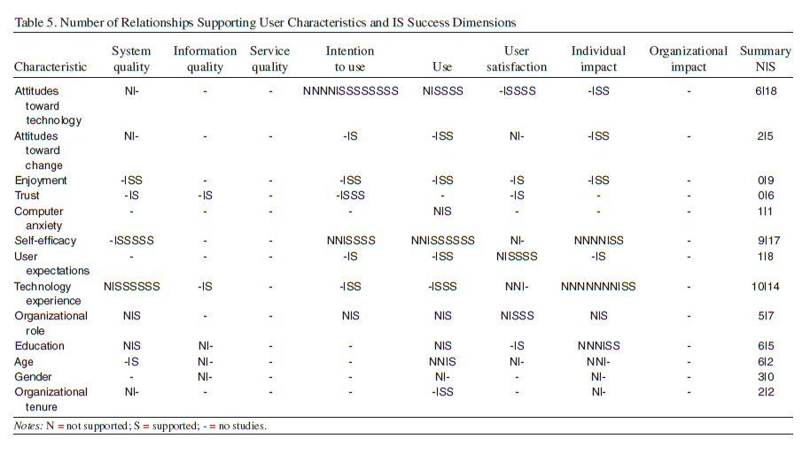
Determinants of IS Success
Information Systems Success: The Quest for the Independent Variables (Petter, Delone & Mclean, 2013)

Slide 19
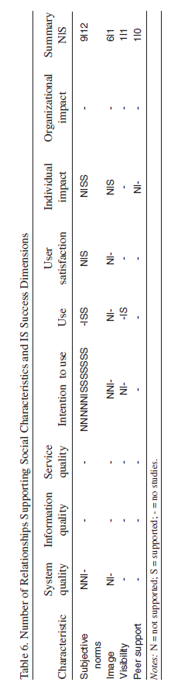
Determinants of IS Success
Social Characteristics - Determinants related to the impact that others within a person’s peer group or social network influence an individual.
No moderate/strong relationship was identified.
Information Systems Success: The Quest for the Independent Variables (Petter, Delone & Mclean, 2013)

Slide 20
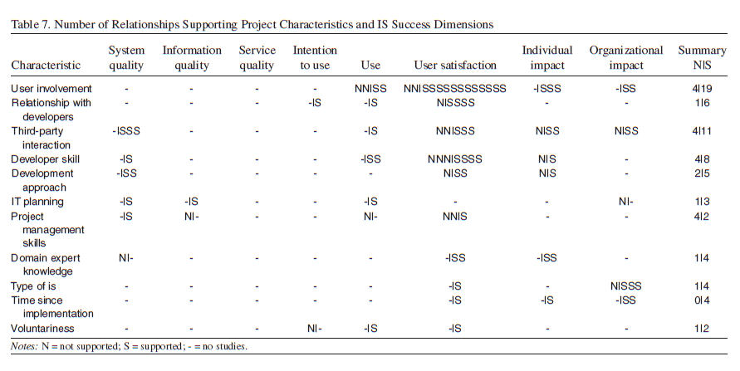
Determinants of IS Success
Project Characteristics - Determinants related to the processes established during a project to identify, develop, and implement an IS.
User involvement, Relationship with Developers, and Domain Expert knowledge were the moderate predictors of IS success and most often associated with User Satisfaction.
Information Systems Success: The Quest for the Independent Variables (Petter, Delone & Mclean, 2013)

Slide 21
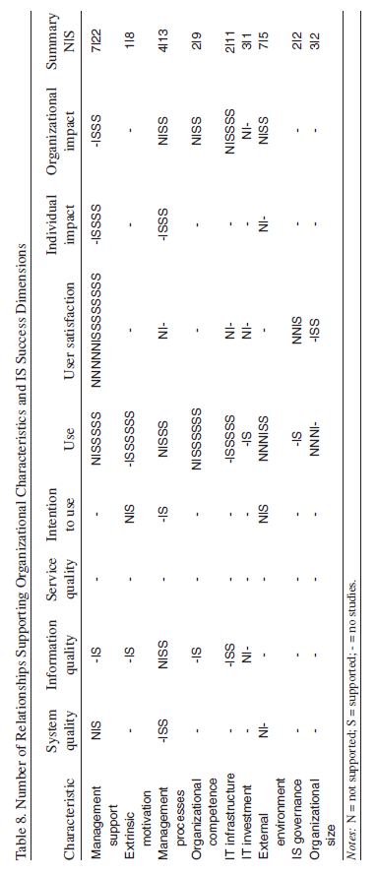
Determinants of IS Success
Organizational Characteristics - Determinants related to the overarching organizational procedures and environment, such as management influences, organizational characteristics, and the organization’s environment.
Extrinsic Motivation and IT Infrastructure have strong support as a predictor of IS success.
Management Support and Organizational Competence have moderate support as a predictor of IS success.
Information Systems Success: The Quest for the Independent Variables (Petter, Delone & Mclean, 2013)

Slide 22
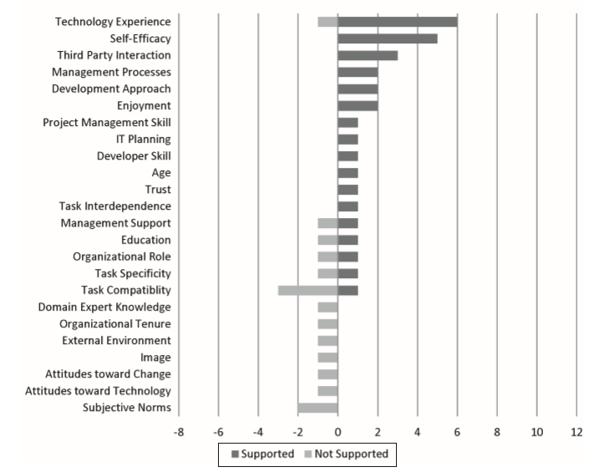
Determinants of IS Success
System Quality Desirable characteristics of an IS.
Technology Experience and the Self-Efficacy are the most studied antecedents .
Information Systems Success: The Quest for the Independent Variables (Petter, Delone & Mclean, 2013)
Notes:
The bar on the righthand side of the graph identifies the number of supported relationships
The bar on the lefthand side identifies the number of results that did not find a relationship between the constructs.

Slide 23
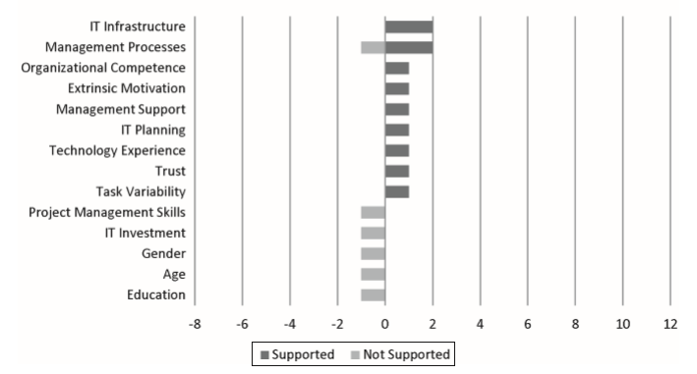
Determinants of IS Success
Information Quality - Desirable characteristics of the system outputs (content, reports, dashboards).
Information Systems Success: The Quest for the Independent Variables (Petter, Delone & Mclean, 2013)

Slide 24
Determinants of IS Success
Determinants of IS Success Dimensions from the Perspective of D&M Model
Service Quality - Quality of the service or support that system users receive from the IS organization and IT support personnel in general or for a specific IS.
No studies that considered the determinants of Service Quality for a specific IS was found.
Information Systems Success: The Quest for the Independent Variables (Petter, Delone & Mclean, 2013)

Slide 25
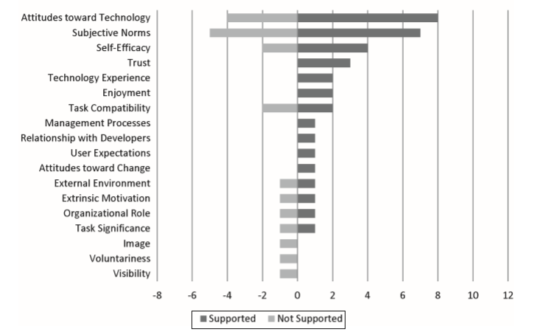
Determinants of IS Success
Intention to Use – The users’ belief about their likelihood to use the IS
The most studied variables to predict Individual’s intention to use are Attitudes toward Technology and Subjective Norms.
Both variables have been studied because of their incorporation in the TAM.
Information Systems Success: The Quest for the Independent Variables (Petter, Delone & Mclean, 2013)

Slide 26
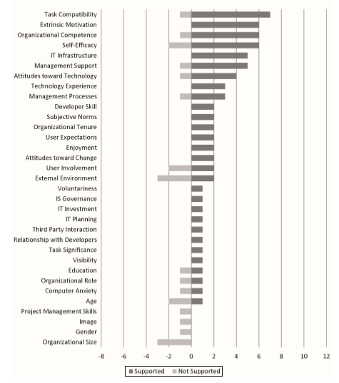
Determinants of IS Success
(System) Use – Degree and manner in which staff and customers utilize the capabilities of an IS.
The strongest determinants for Use include Organizational Competence, Extrinsic Motivation, and IT Infrastructure.
Information Systems Success: The Quest for the Independent Variables (Petter, Delone & Mclean, 2013)

Slide 27
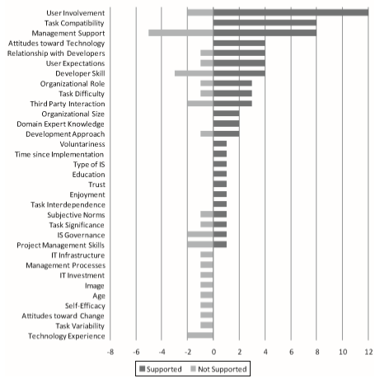
Determinants of IS Success
User Satisfaction – Users’ level of satisfaction with the IS.
Task Compatibility and Attitudes toward Technology are the strong determinants of User Satisfaction.
Task Difficulty has an inverse relationship with User Satisfaction in that the easier the task, the more satisfied the user with the IS.
Information Systems Success: The Quest for the Independent Variables (Petter, Delone & Mclean, 2013)

Slide 28
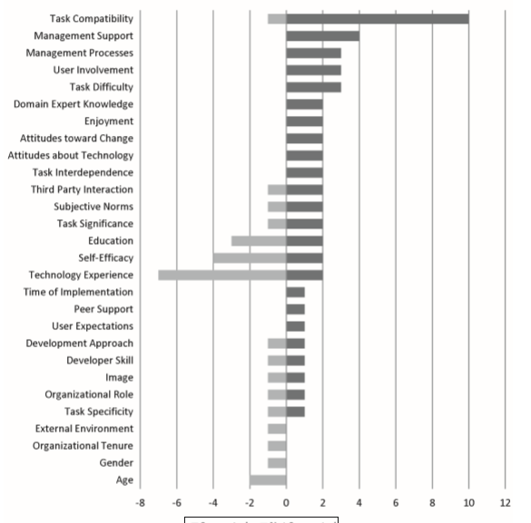
Determinants of IS Success
Individual Impact – Are the benefits to be measured from the individual’s perspective? (his or her employer)
Task Compatibility is a strong determinant of Individual Impact.
Unlike initial implementations of the system, it becomes more important when the system was adopted to better fit work practices and requirements.
Information Systems Success: The Quest for the Independent Variables (Petter, Delone & Mclean, 2013)

Slide 29
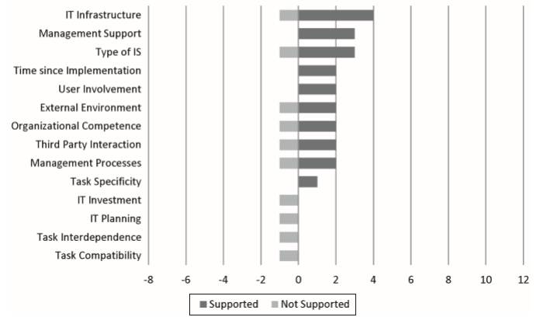
Determinants of IS Success
Organizational Impact – Are the benefits to be measured from the organizational perspective?
A few studies have studied the effects of a specific IS on the organization.
Information Systems Success: The Quest for the Independent Variables (Petter, Delone & Mclean, 2013)

Slide 30
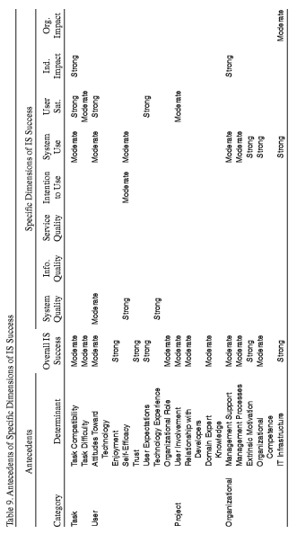
Determinants of IS Success
Information Systems Success: The Quest for the Independent Variables (Petter, Delone & Mclean, 2013)
Notes:
Table summarizes the determinants that have been found consistently relate to IS success (across all dimensions of IS Success)
or determinants that have been found to be related to a specific dimension of IS Success.

Slide 31
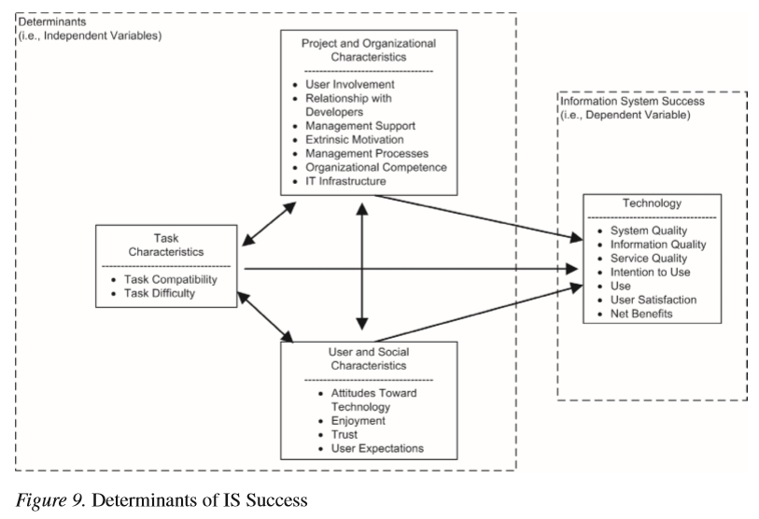
Determinants of IS Success
Information Systems Success: The Quest for the Independent Variables (Petter, Delone & Mclean, 2013)

Slide 32
Determinants of IS Success
Gaps in the Knowledge of IS Success Determinants
Some variables of interest are understudied and others have generated mixed result that may be due to inconsistencies in measurement.
There is a need for the consistent measurement of dependent variables to develop a collective understanding of the significance of determinants of IS success.
Research on the determinants of some key dimensions of IS success are lacking.
No studies that investigated the determinants of Service Quality for a specific IS.
For determinants of Organizational Impact, only IT infrastructure is found to have a positive influence on Organizational Impact. More research is needed to investigate the relationship between other success factors and the Organizational Impact derived from individual IS.
Many studies that consider Intention to Use as an IS success variable rely on theories such as the Technology Acceptance Model, theory of Reasoned Action, or theory of Planned Behavior for their theoretical reasoning; therefore, most of the determinants for Intention to Use are the characteristics of the individuals using the IS. It is also likely that other variables (beyond user characteristics) would influence Intention to Use.
Information Systems Success: The Quest for the Independent Variables (Petter, Delone & Mclean, 2013)

Slide 33
Determinants of IS Success
Future Research Road Map
Researchers identified 4 areas for future research:
Interactions Among Antecedents: the study of the interactions among success factor variables
The interactions among user, task, and structure characteristics may contribute to higher—or lower—levels of success.
Antecedents of Specific IS Success Dimensions:
The relationship between task (e.g., task compatibility), project (e.g., user involvement), and organizational (e.g., management support) variables and Intention to Use needs to be explored to allow managers to better understand how to motivate users and customers to be interested in using IS.
Specific Antecedents:
Project Management and IS Success:
More exploration of the impact of project variables such as developer skills, development approach, and user involvement on System Quality is needed to determine the relationships between the project management tasks and the resulting technical quality of the system.
Further research exploring the impact of project variables such as IT planning, development approach, project management skills, and domain expertise on the success of resulting systems is warranted.
Information Systems Success: The Quest for the Independent Variables (Petter, Delone & Mclean, 2013)

Slide 34
Determinants of IS Success
Future Research Road Map
Researchers identified 4 areas for future research:
Specific Antecedents:
The lack of association between users’ technology experience and Individual Impact needs further research to better understand the relationship (or lack of relationship) between them.
The impact of user involvement on System Quality, Information Quality, and System Use needs further study.
More research is needed to explore the relationship between It Investment in a specific IS and the individual and organizational effects of that IS.
Research should examine the impact of social variables, such as subjective norms, on the success of IS.
Information Systems Success: The Quest for the Independent Variables (Petter, Delone & Mclean, 2013)

Slide 35
Determinants of IS Success
Limitations of the review
Focus of the study is IS success (a broader topic of success) rather than simply on acceptance.
Researchers focused on the studies centered around IS effectiveness and IS success as opposed to the IS adoption and acceptance literature.
The analysis focused only on direct relationships between specific determinants and IS success.
The interactions among independent variables directly affecting IS Success have not been explored.
The study is an overview of the determinants of IS success, with a focus on breadth.
The depth must come in future work that examines some of these relationships in more detail, particularly those with conflicting results or to identify which determinants are the most important predictors of IS success.
Information Systems Success: The Quest for the Independent Variables (Petter, Delone & Mclean, 2013)

